Slide 1
Comparative Study of 8085, 6502, And NSC Microprocessors

Slide 2
Welcome
Submitted to
Course Title: Computer Architecture
Course Code: CSE360
Course Instructor: Assoc. Prof. Dr. Ahmed Wasif Reza, Department of Computer Science &amp; Engineering.
Section: 01
Semester: Summer 2021
Submitted by
Name: Fariha Tabassum
ID: 2018-3-60-077
Name: Plabon Hasan
ID: 2018-2-60-028
Name: Tanjina Akter Ripa
ID: 2018-3-60-024

Slide 3
Introduction
A processor or CPU is a portion of hardware (an integrated electronic circuit) that interprets the instructions as arithmetical, logical, input/output (I/O), and other basic instructions that enforce by a Computer Operating System. We are going to show you a comparative study about microprocessor 8085, 6502 and NSC(National Semiconductor). Now, there is a question what is microprocessor ?

Slide 4
What is Microprocessor ?
The microprocessor is any of a type of miniature electronic device (the central unit of a computer system) that contains arithmetic and logic operations, which usually perform actions like adding, subtracting, transferring numbers from one area to another, and comparing two numbers, despite that in arithmetic operation the multiplications and division cannot be perform.

Slide 5
Key Differences between Processor and Microprocessor
The microprocessor is the latest and upgraded version of the processor or CPU.
CPUs or processors can be microprocessors but all microprocessors are not CPUs.
Although microprocessor is the latest and advanced technology but still, the main processing function of the computer is controlled by the processor. Etc.

Slide 6
Types of Microprocessor
CISC (Complex Instruction Set Computer) → Intel 386, Intel 486, IBM 370/168, VAX 11/780, Intel 8048, Pentium, Pentium Pro, Pentium II, Pentium III, etc.
RISC (Reduced Instruction Set Computer) → IBM RS6000, DEC Alpha 21064, DEC Alpha 21164, Power PC: 601, 604, 615, 620, DEC Alpha: 210642, 211066, 21068, 21164, MIPS: TS (R10000) RISC Processor, PA-RISC: HP 7100LC etc.
EPIC (Explicitly Parallel Instruction Computing) → IA-64 (Intel Architecture-64), etc.

Slide 7
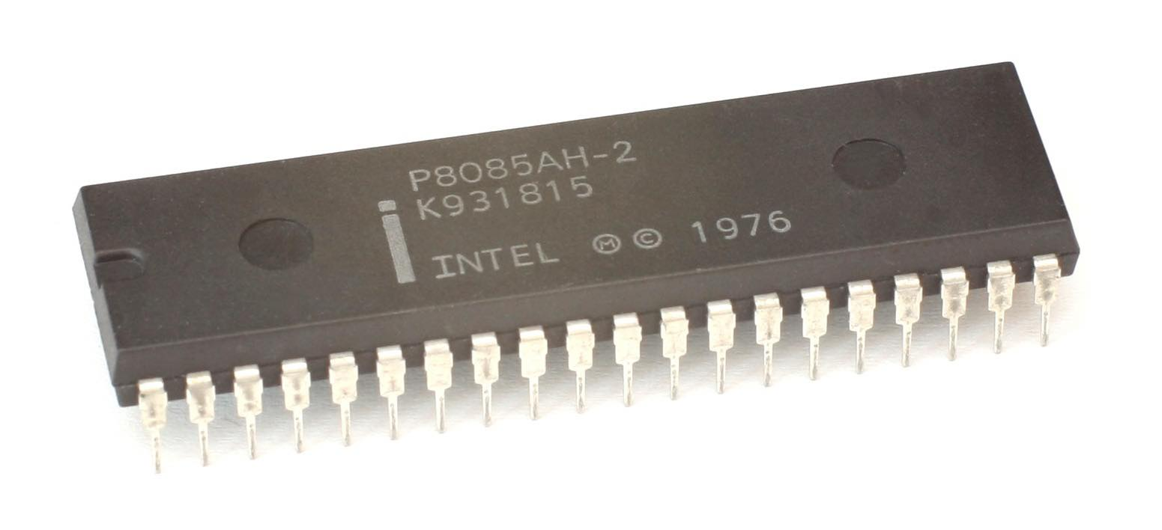
8085 Microprocessor
8085 microprocessor was the first commercially successful microprocessor by Intel.
8085 microprocessor is an 8-bit microprocessor as it operates on 8 bits at a time and is created with N-MOS technology also it spread some unique characteristics and this is the reason it still holds popularity among the microprocessors.

Slide 8
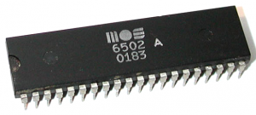
6502 Microprocessor
6502 (MOS Technology) microprocessor an eight-bit microprocessor was designed by MOS Technology around 1975 and made by Rockwell.
6502 microprocessor was designed by a small team led by Chuck Peddle for MOS Technology.
The design team had formerly worked at Motorola on the Motorola 6800 project.
6502 is essentially a simplified, less expensive, and faster version of that design.

Slide 9
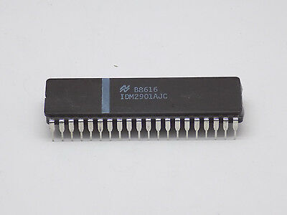
NSC Micro-processor
National Semiconductor or NSC was an American semiconductor manufacturer which specialized in analog devices and subsystems, formerly with headquarters in Santa Clara, California.
The company produced power management integrated circuit, display drivers, audio and operational amplifiers, communication interface products and data conversion solutions.
National's key markets included wireless handsets, displays and a variety of broad electronics markets, including medical, automotive, industrial and test and measurement applications.

Slide 10
Clock Rate of 8085, 6502, and NSC Microprocessor
Each and every CPU, there is a particular wire that turns on and off at a steady rate to help keep everything in sync and that wire is called the clock. In 6502 processor clock turning twice in a second. Modern CPUs are measured in gigahertz. Giga meaning billion and hertz meaning times per second. So the clock in modern CPUs turns on several billion times per second. As well as 8085 microprocessor clock rate is 3, 5 and 6 megahertz. National Semiconductor or NSC microprocessor 500 kHz, 715 kHz, and 1 Mega Hz. That speed is what allows CPUs to do very complicated things so quickly.

Slide 11
More Compare of 8085 , 6502 and NSC Microprocessor
Topic of Comparison:
Register
Clock Circuit
Accumulator
Temporary Register
Uses
Pin Diagram
Internal Architecture
Comparison Chart

Slide 12
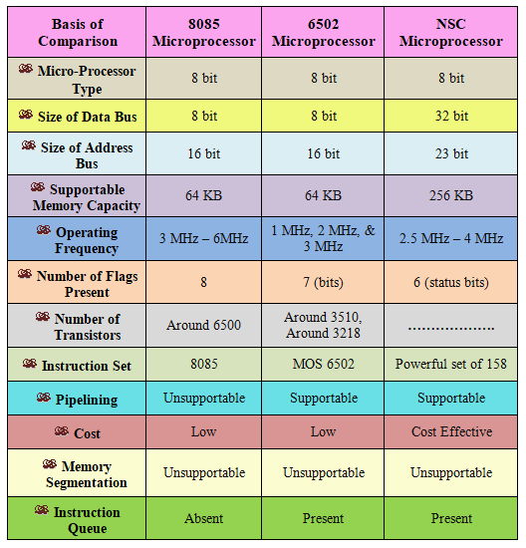
Comparison Chart

Slide 13
Analysis
8085 is an 8-bit microprocessor as it operates on 8 bits at a time and is created with N-MOS technology. Basically, 8085 was the first commercially successful microprocessor by Intel.
6502 has three basic layers. The bottom layer is a wafer of silicon known as the "substrate." Above it is a thin layer of polysilicon wires that form transistors and build circuits around the chip. The top layer is thick metal wiring primarily for supplying power.
A detailed analysis of the SEU vulnerability of the Zilog Z-80 microprocessor is presented based upon data obtained with heavy ions and protons. The data which made this analysis possible, a novel test technique was developed which associates all upsets with the machine cycle during which they first appear on the device pins. Limited data for the NSC-800 are included.

Slide 14
Conclusion
One of the greatest inventions to technology was the microprocessor because it makes life easier to inflict effect on technologic engineering, different prospects of life, and stores data larger than the size of the actual chip which makes technology easier to use. Though 8085, 6502, and NSC microprocessors are from different constitutions they all make an impact on a person's life in different ways and also better ways day by day. Overall can say that the 8085 microprocessor, 6502 microprocessor, and NSC microprocessor these three microprocessors are different but they have been used for the same purpose.

Slide 15
Thank You

Slide 16



